Slide 1
Twitter Client
Group 13
Nguyễn Hoàng Minh BI9-166
Trịnh Tuấn Minh BI9-168
Phí Nguyễn Hải Minh BI10-120
Lê Tuấn Khang BI8-081

Slide 2
Table of contents
01
02
03
04
05
06
Introduction
Architecture
Activities
Optimization + Networking
Demo
Conclusion
Notes:
• What does your app do?
• Why do we need it
2 • What are the main components of your app?
3. What are your activities?
• What does each of them do?
4. UI overdraw
5. Demo: Functionality
6. What was done
• What was NOT done
• Possible future development

Slide 3
01
Introduction
Why we need Twitter and what can it do

Slide 4
Twitter
What is Twitter
Online news & social network
Communicate via tweets
What can Twitter do
Create your own account
Tweeting (short message for followers)
Follow others and receive news
Why Twitter
Useful content and interesting news
Marketing tool
Social messaging

Slide 5
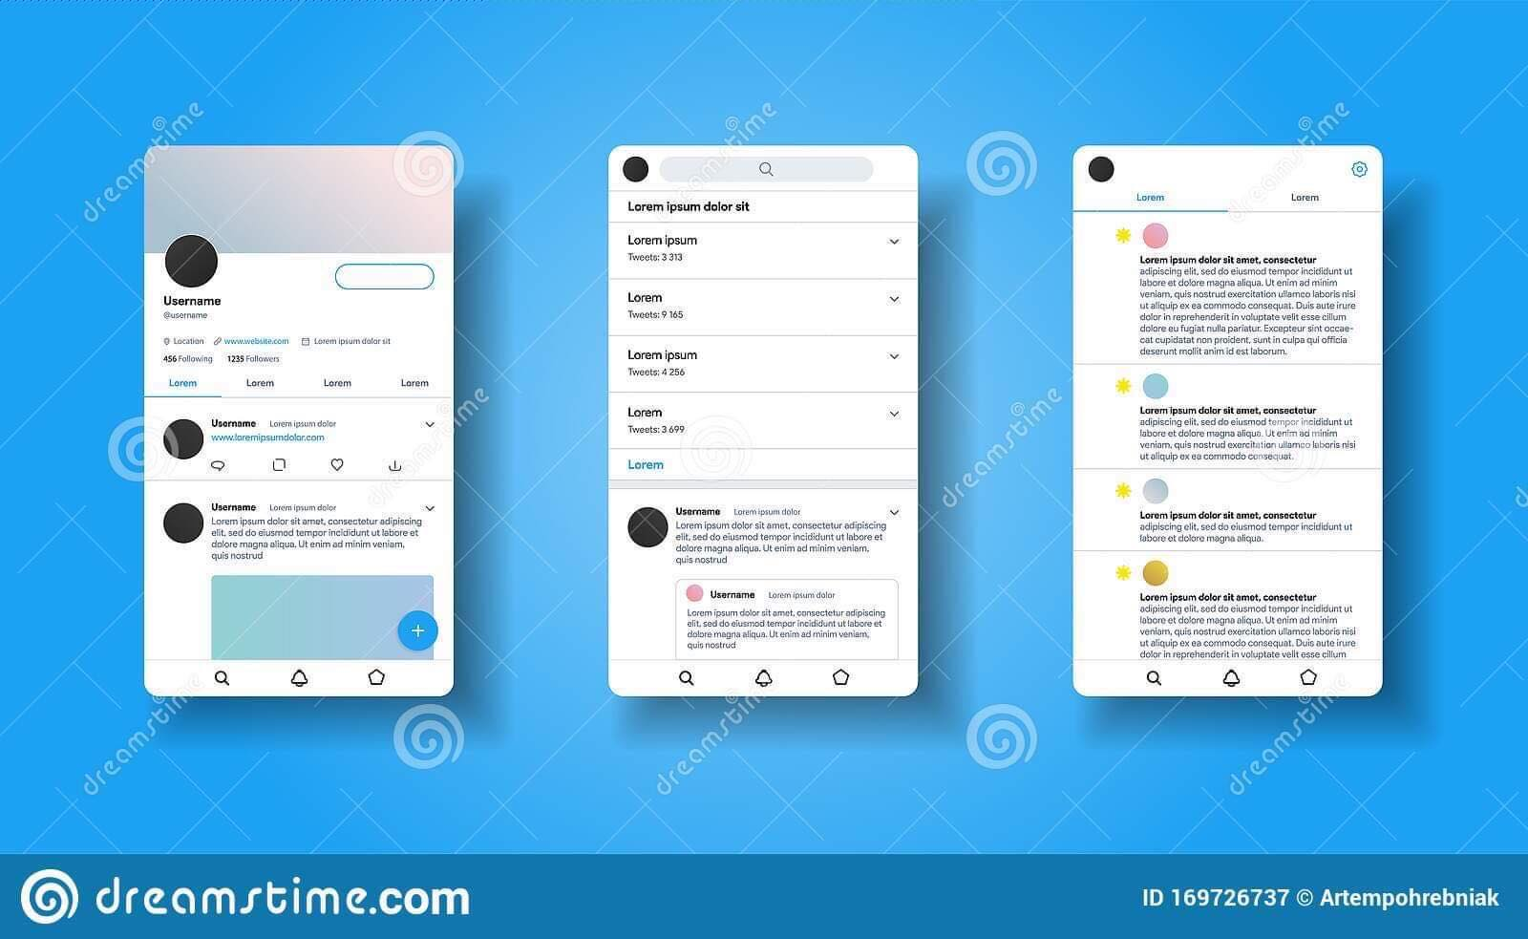

Slide 6
02
Architecture
Main Components

Slide 7
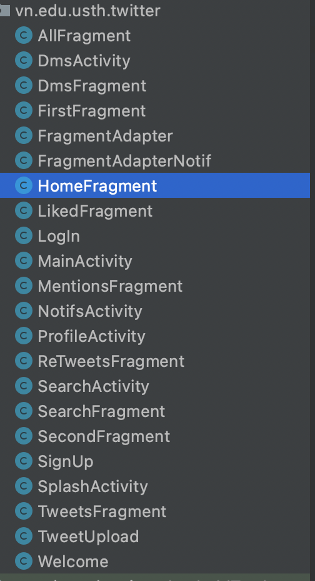
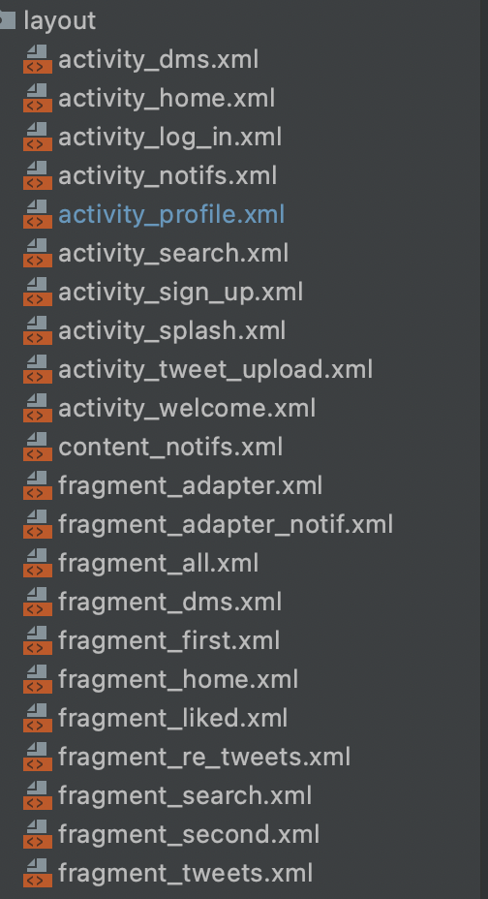
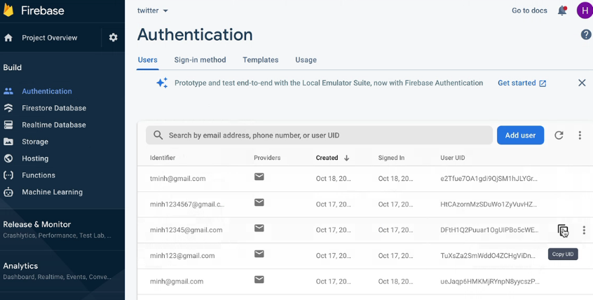
Main Components
Base Activity, Single Fragment Activity
Database & Client’s data: Firebase
Res (layout design)

Slide 8
03
Activities
Main activities & Fragments

Slide 9
Main Activities & Fragments
- Fragment Adapter: Manage between fragments
- Home Activity: Manage Home Activity and Navbar
- Profile Activity: User profile
- Liked, Retweets and Tweets Fragments
- Signup Activity
- DMS Activity & Fragment: Manage Sending message
- Search Activity: Manage Search
- Notifs Activity: Manage notification activity
- Mention Fragmen and ALL Fragment: Notification fragments
- Search Activity and Search Fragments: Manage Search
- Welcome Activity: Manage Welcome page

Slide 10
04
Optimization and Networking
UI Overdraw & Networking

Slide 11
Before Midterm

Slide 12
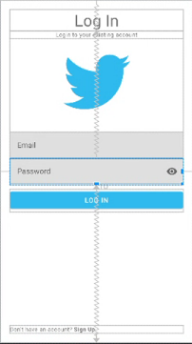
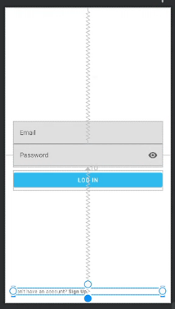
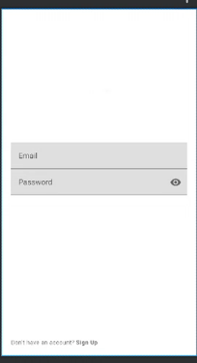

Log in

Slide 13
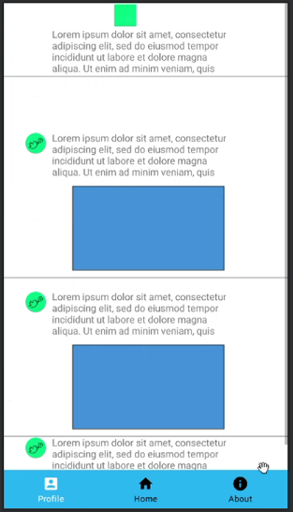
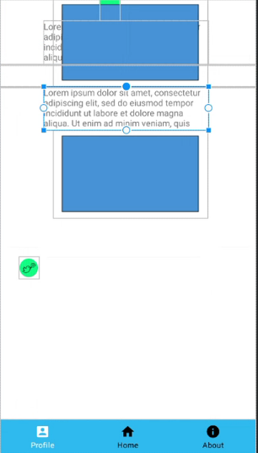
Home Page

Slide 14
After midterm

Slide 15
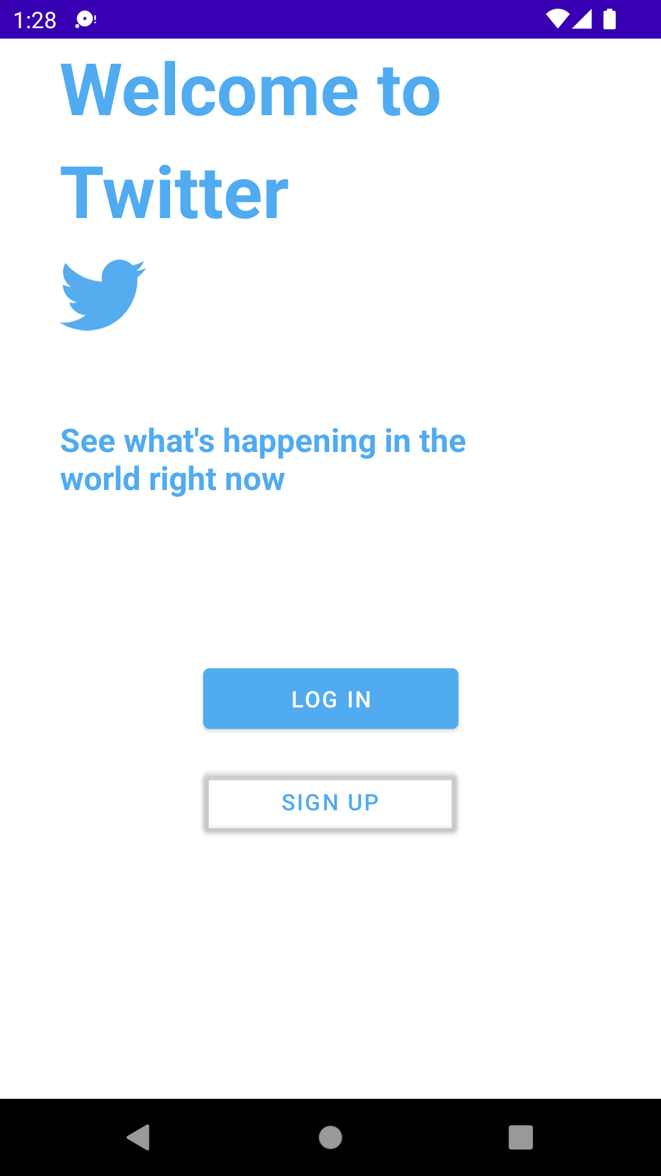
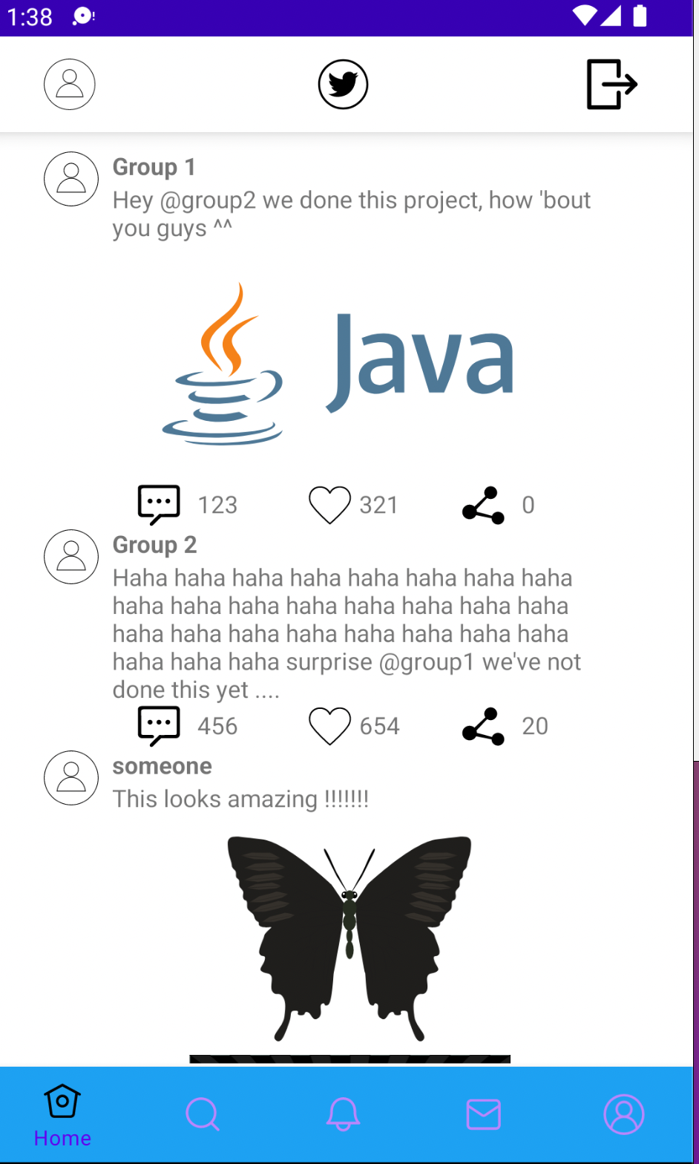
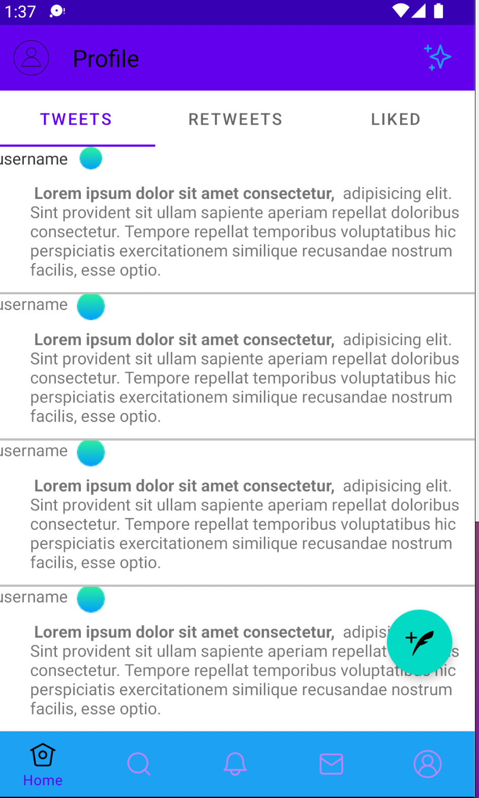
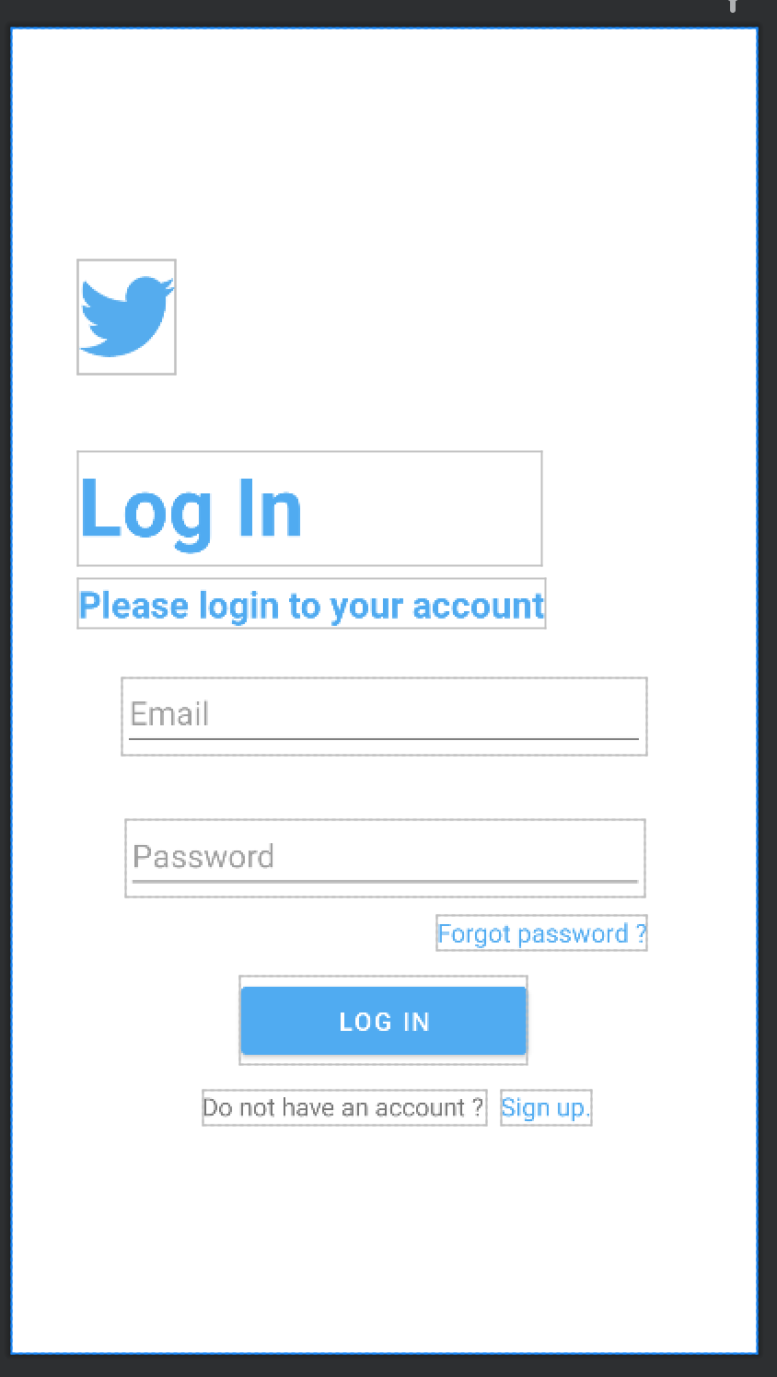

Slide 16
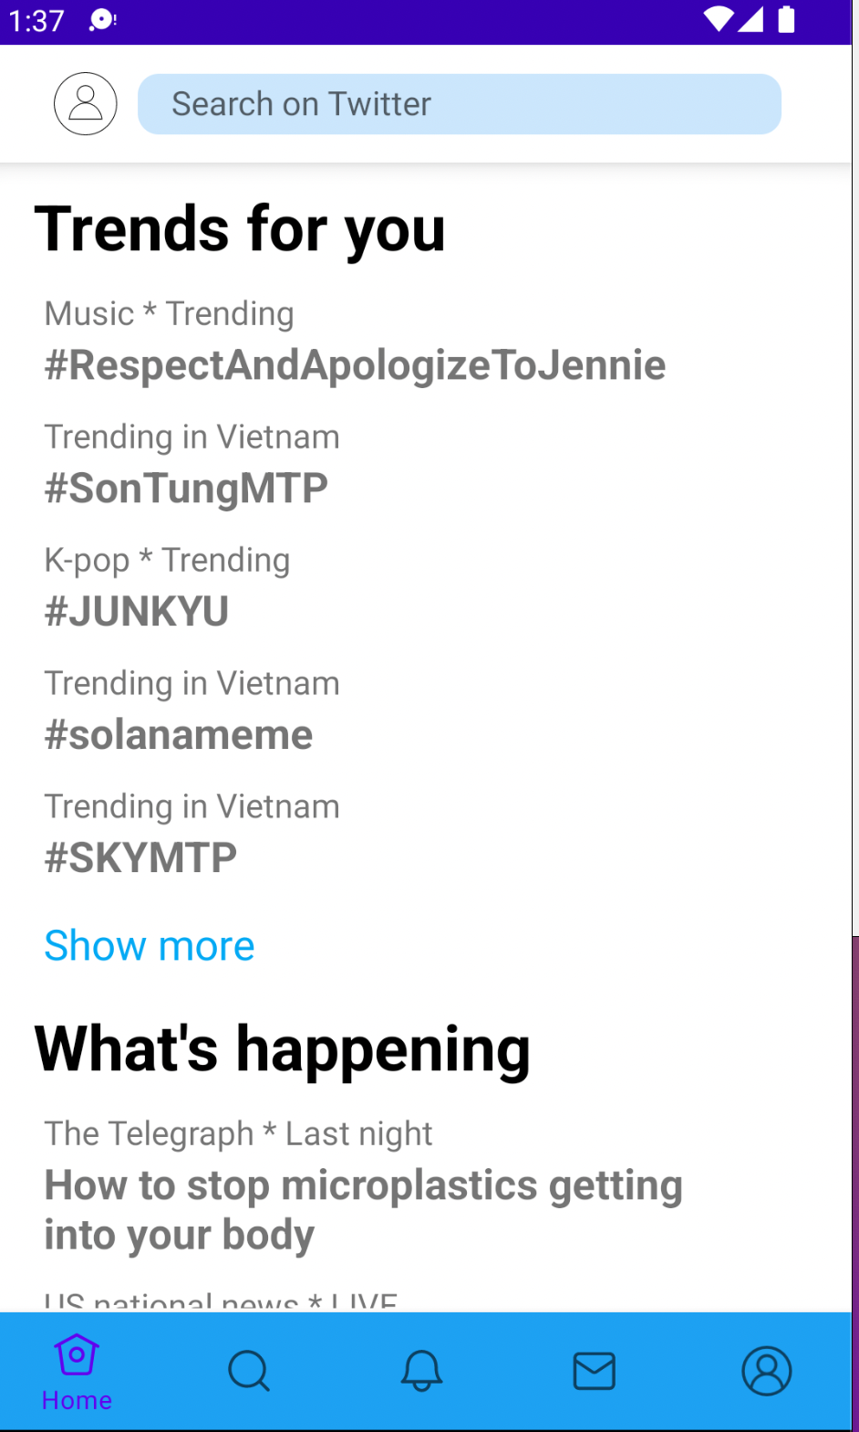
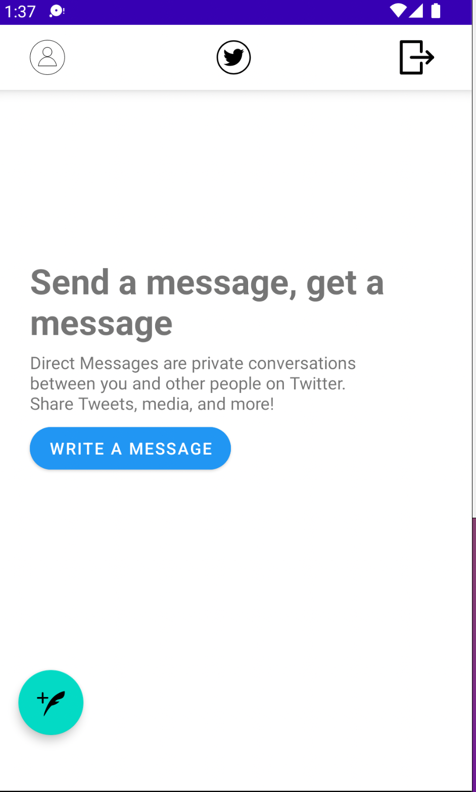

Slide 17
Networking
Firebase for Authentication
Main API requested from Twitter

Slide 18
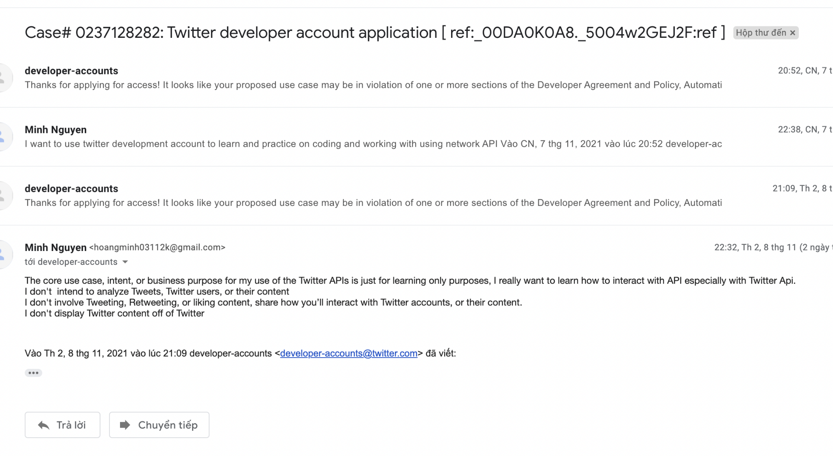
Networking
Firebase for Authentication
Main API requested from Twitter

Slide 19
05
Demo
Functionality

Slide 20
06
Conclusion
Current status & Future Development

Slide 21
Conclusion
What was done
Future Development
- Log in, Log out, Sign up
- Lay out for user and home page
- Lay out for tweets, retweets and liked
- Navigation Bar
- Tweets, retweets and liked functionality
- Networking
- Profile configuration

Slide 22
Thank
You
Group 13 - Twitter Client

